Slide 1
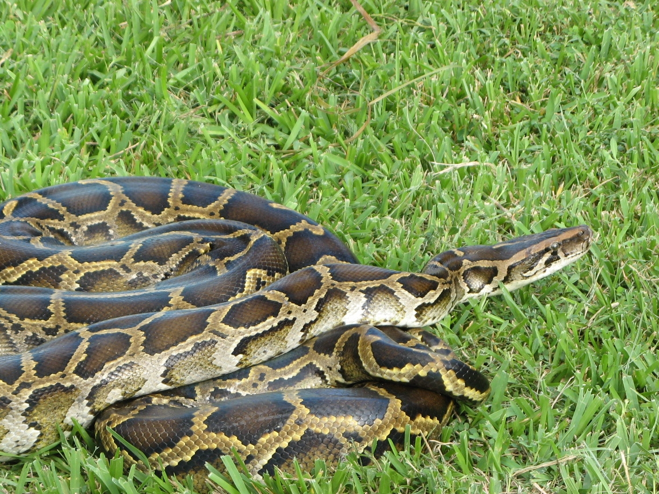
The Problem
People are buying exotic species as pets. Some of these animals are released when their owners aren’t able to care for them anymore.

Slide 2
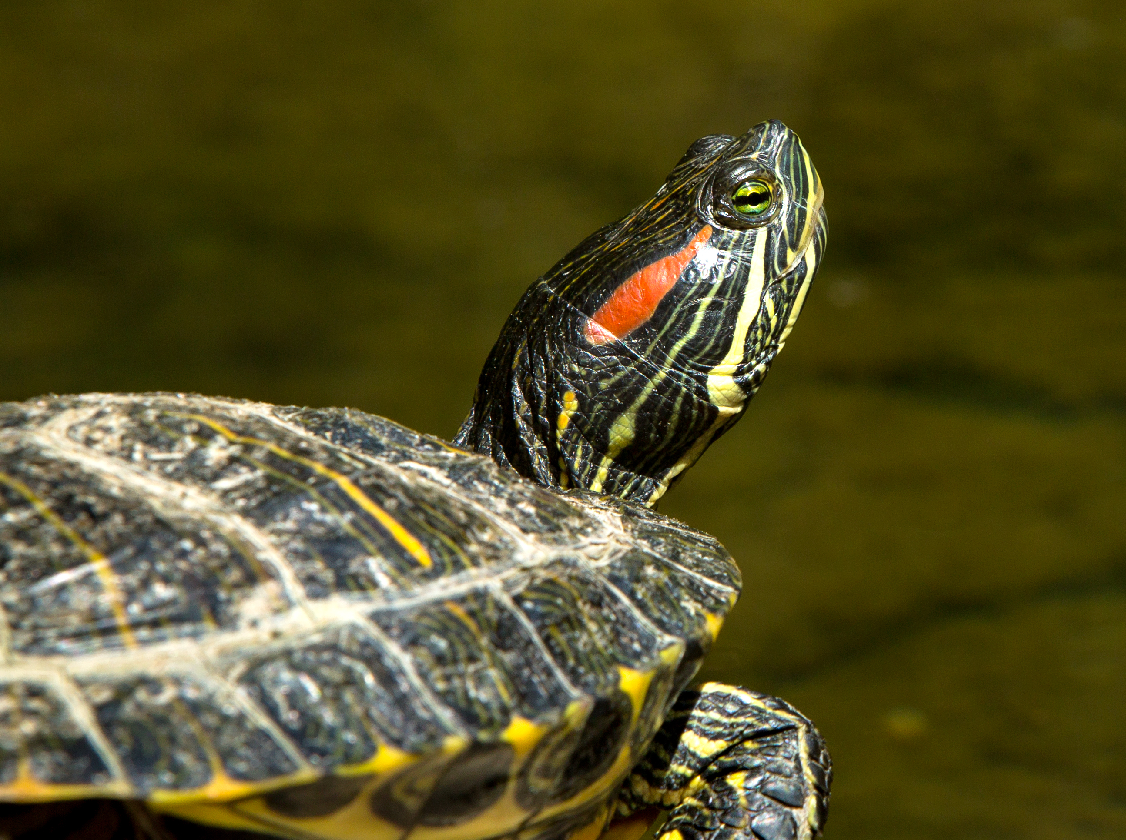
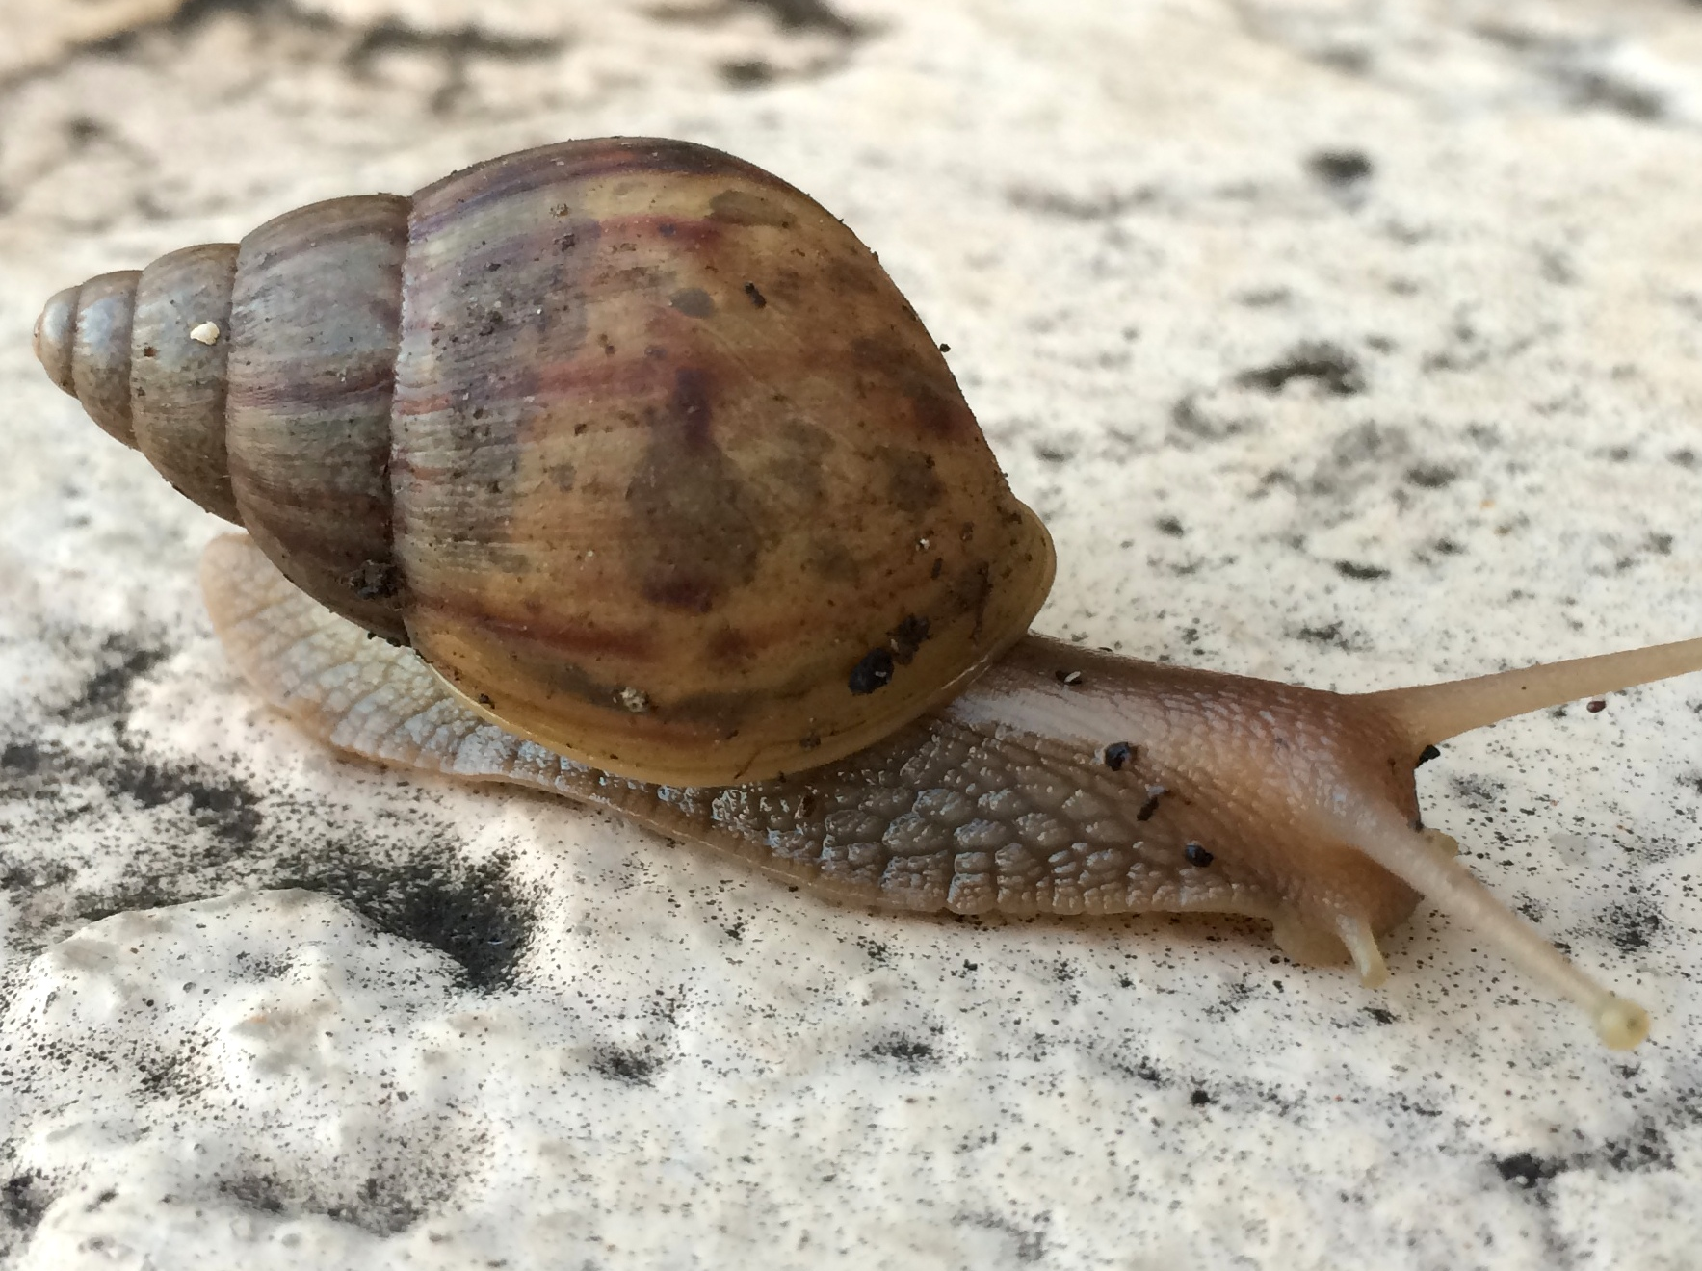
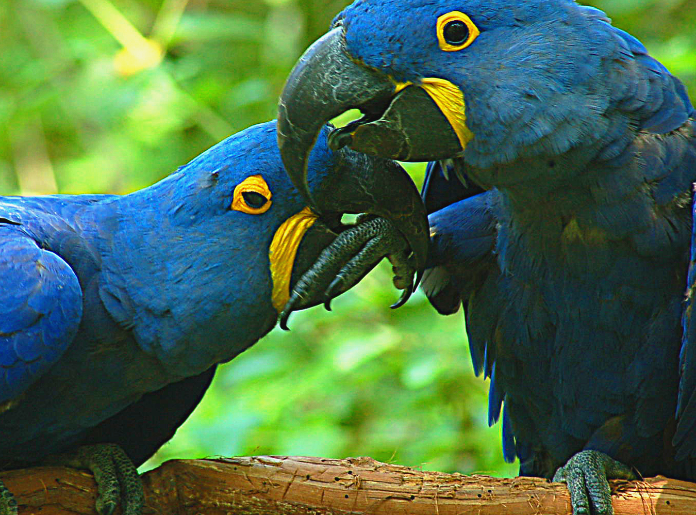
Consequences of Exotic Pets
Invasive Species
Released pets can start breeding, taking over habitats, spreading diseases, and preying on native animals.
1
Neighborhood Nuisances
Large pets like pythons and alligators pose risks to pets and people. Others, like Giant African Snails, eat every plant in sight.
2
Overexploitation
Some exotic pets are captured illegally from the wild. Their wild populations are rapidly dwindling as a result.
3

Slide 3
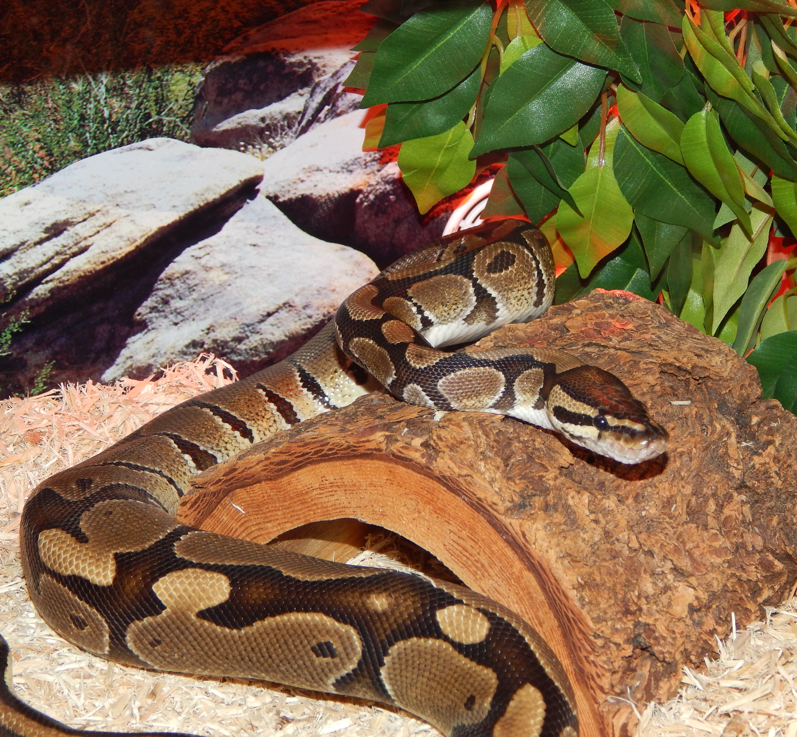
1
What Can You Do about It?
Think Before You Buy
Future owners should consider all the care, supplies, and ongoing expenses that a certain pet will need in its lifetime.
If you decide you are able to care for a pet for the rest of its life, consider adopting an unwanted pet instead of buying one from a pet shop. That way you won’t contribute to the trade of exotic animals.

Slide 4
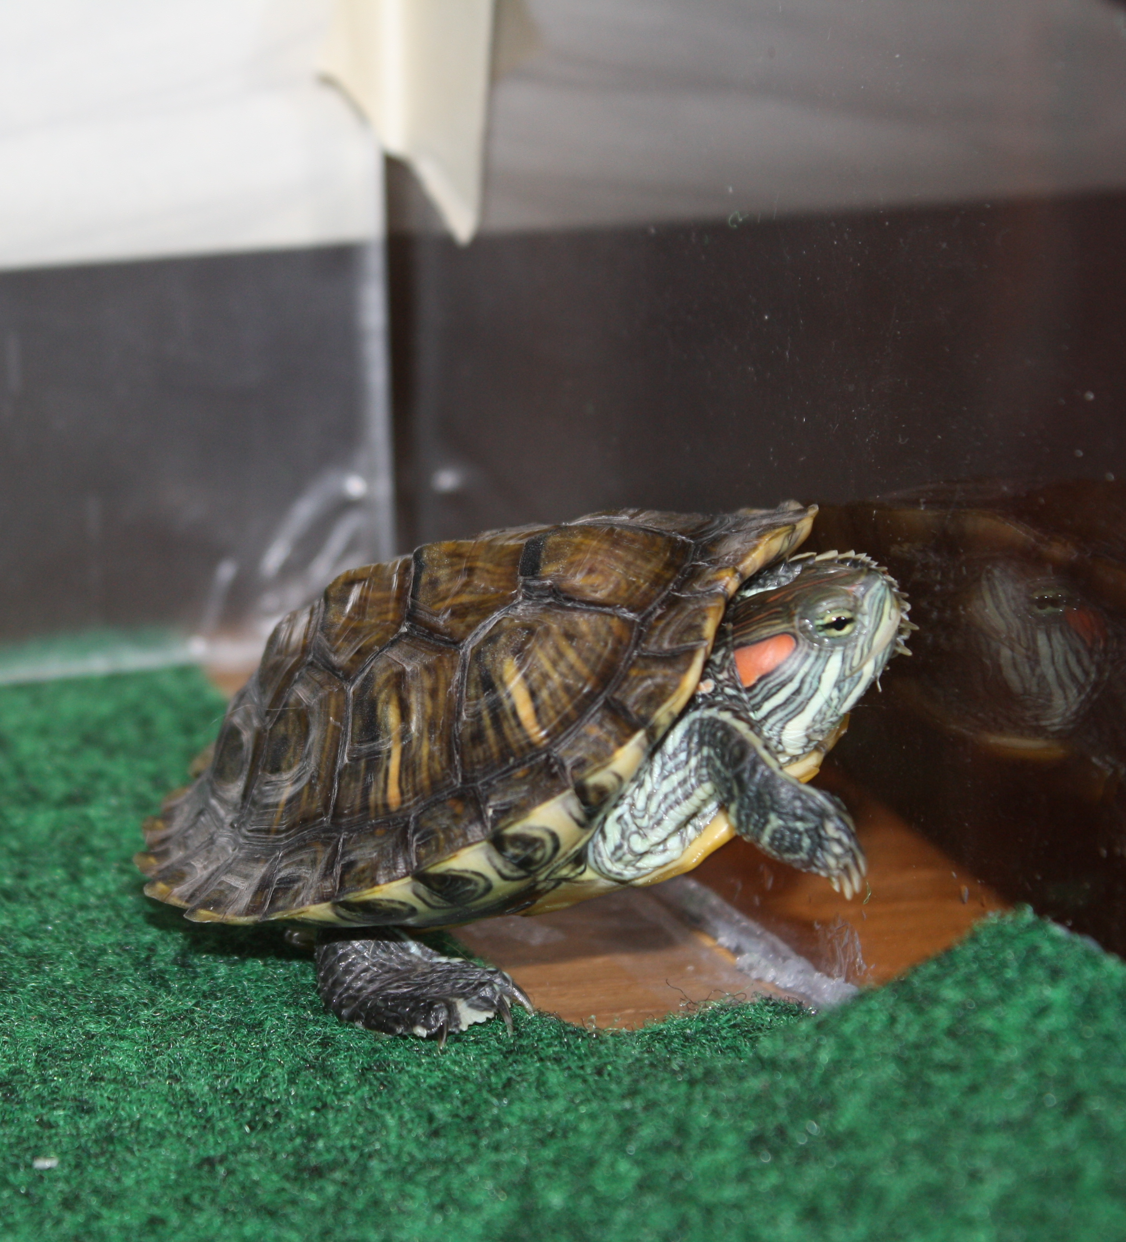
2
What Can You Do about It?
Find a New Owner
If you have a pet you can no longer care for, find a new owner rather than releasing it.
Post on adoption websites and newspapers about your pet.
Find organizations that will find foster homes and help with adoptions.

Slide 5
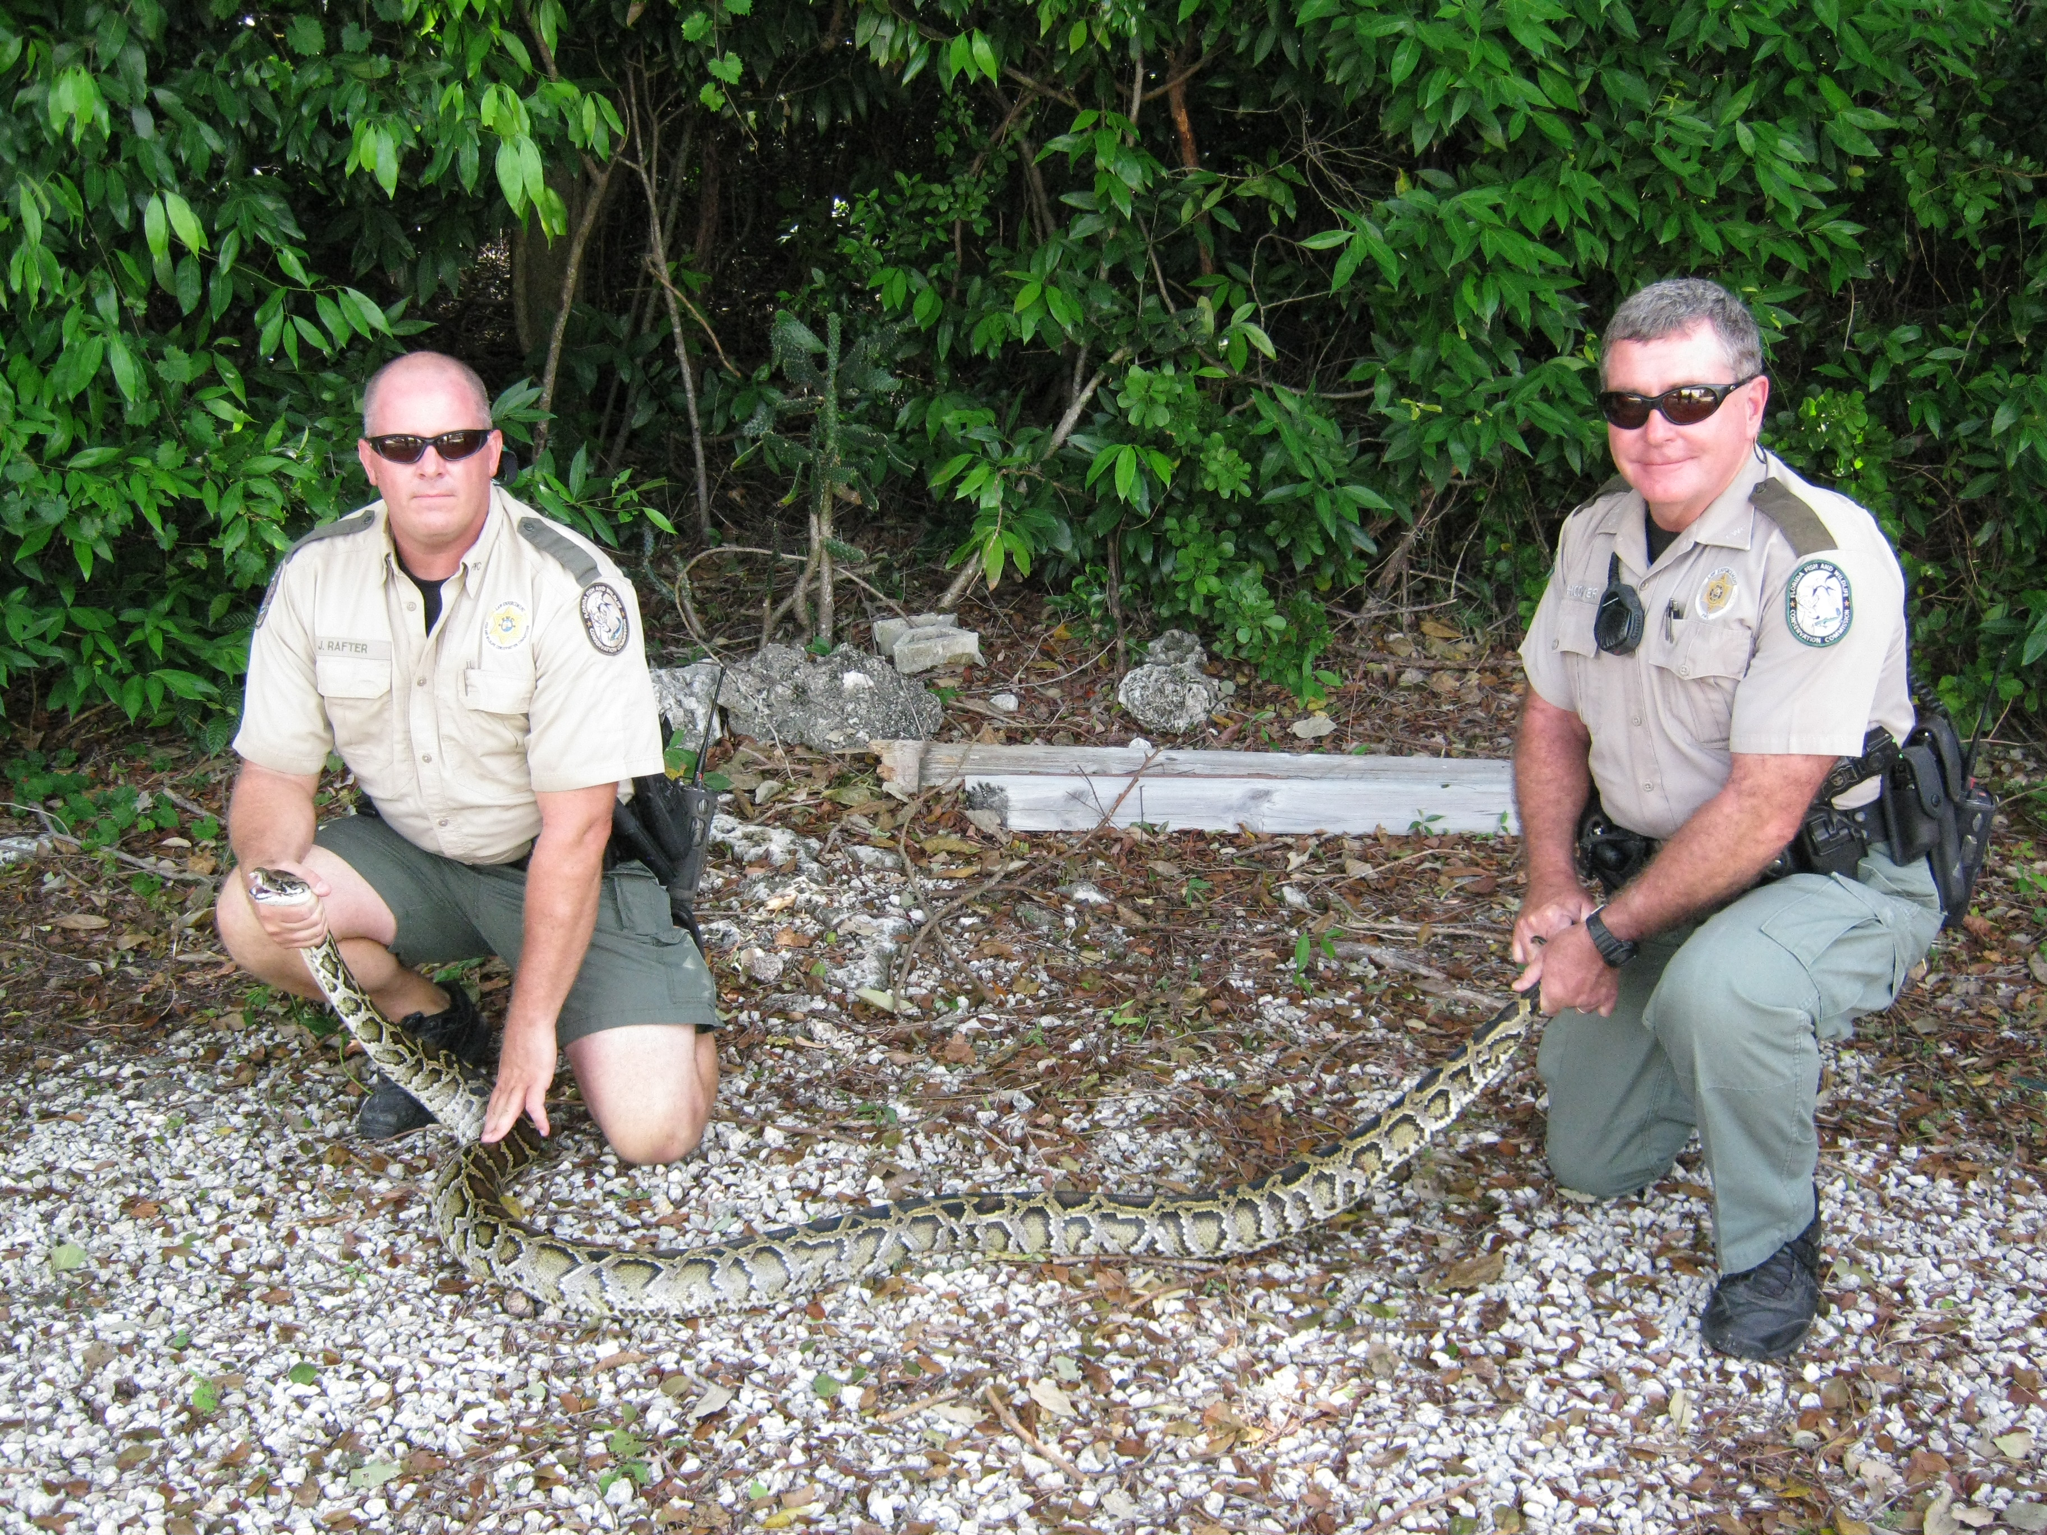
3
What Can You Do about It?
Notify Authorities
If you find an exotic animal in the wild:
If it’s dangerous, contact Animal Control for removal.
If it’s nonharmful, capture it and contact Animal Control.
Educate others about not releasing pets into the wild!

Slide 6
Credits
Photos used under Creative Commons licenses:
https://creativecommons.org/licenses/by/2.0/legalcode
“Burmese Python” by U.S. Fish and Wildlife Service via flickr.com (cropped)
“Red-Eared Slider” by Sheila Sund via flickr.com (cropped)
https://creativecommons.org/licenses/by-nc-nd/2.0/legalcode
“Hyacinth Macaw” by Travis Hightower via flickr.com
“Fender, Wants Dinner” by John via flickr.com
https://creativecommons.org/licenses/by/2.0/legalcode
“IMG_1220” (pet turtle) by Jessi Swickvia flickr.com (cropped)
https://creativecommons.org/licenses/by-nd/2.0/legalcode
“Python Caught!” by Florida Fish and Wildlife via flickr.com

